Slide 1

MAULANA AZAD NATIONAL INSTITUTE OF TECHNOLOGY
MAJOR PROJECT PRESENTATION
By
ANAND NAMDEV
AMIT BIRLA
ADISH JAIN
SUNEEL KUMAR

Slide 2
Document Classification using Multinomial Naïve Bayes Model

Slide 3
Problem Definition & Objective
CEO’s and senior executives receive 100’s of mail per day.
Huge amount of time is spent on manually reading each mail/document.
Automated text categorization is attractive as it removes the overhead of manually organizing documents.
Task is to design a Machine Learning model which can automatically classify a collection of text documents into exclusive categories using training documents.

Slide 4

What is the Subject of this Article?
Subject Category
Sports
Science
Medical
Literature
Technology
Arts
Spam
…

Slide 5
EXAMPLES OF TEXT CLASSIFICATION
CLASSES=BINARY
“spam” / “not spam”
CLASSES =TOPICS
“finance” / “sports” / “politics”
CLASSES =OPINION
“like” / “hate” / “neutral”
CLASSES =TOPICS
“AI” / “Theory” / “Graphics”
CLASSES =AUTHOR
“Shakespeare” / “Marlowe” / “Ben Jonson”

Slide 6
Introduction
Data mining is the process of applying machine learning techniques for extracting knowledge from stored data
Classification is one of the important aspect of data mining
Classification done on text is known as document classification
Document classification is used in various real world problems

Slide 7
Classification Methods: Supervised Machine Learning
Input:
A document d
A fixed set of classed C = {c1, c2,…, cj }
A training set of m hand-labeled documents (d1,c1),…,(dm, cm)
Output
A learned classifier У : d → C

Slide 8
Architecture
Project Over flow
The project workflow is divided into 3 phases
Preprocessing
Training
Testing

Slide 9
Preprocessing
Cleaning
Case folding
Remove inbuilt stopwords
Remove Additional stopwords
Stemming and lemmatization

Slide 10

Training
Create Dictionary (V)
For each class
True
Create Text
For each term of V
False
True
False
Tct ← TF( T_{j}, C_{i})
Condprob[t][c] ←
$$\frac{1+TF\left(t_{i},c_{j}\right)}{\left|T\right|+\sum_{tk ∈T}{TF\left(t_{i},c_{j}\right)}}$$
Return condprob

Slide 11
Testing
Extract Vocab (w)
For each class
False
True
For each term of w
False
True
Return max(score)
Score [c_{i}] += condprob [t][c]

Slide 12
Naïve Bayes Algorithm
Apply preprocessing steps like cleaning of data, stopwords removal and stemming
Build the Vocabulary as the list of all distinct words that appear in all the documents of the training set.
The words in the vocabulary become the feature vector, assuming that classification is independent of the positions of the words
Each document in the training set becomes a record with frequencies for each word in the Vocabulary.
Train the classifier based on the training data set, by computing the prior probabilities for each class and attributes.
Evaluate the results on Test data

Slide 13

Bayes’ Rule Applied to Documents and Classes
For a documents d and a class C, applying Bayes Rule
$$P\left(c/d\right)= \frac{P\left(d/c\right)P(c)}{P(d)}$$

Slide 14

Naïve Bayes Classifier
C_{MAP} = argmax P( c / d )
c € C
= argmax$\frac{P\left(d/c\right)P(c)}{P(d)}$
= argmax P(d | c) P(c )
c € C
c € C

Slide 15

Naïve Bayes Classifier
= argmax P(d | c) P(c )
= argmax P(X₁, X₂, … , X_{n} |C) P(C)
c € C
= argmax P(C_{j})$\prod{P(X|C})$
c € C
c € C
x € X

Slide 16

Fraction of times word Xi appears among all words in documents of topic Cj
$$P\left(X_{i} | C_{j}\right)= \frac{count\left(X_{i} | C_{j}\right)}{\sum_{x∈V}{count\left(X_{i} | C_{j}\right)}}$$
Create mega-documents for topic j by concatenating all docs in this topic
Use frequency of X in mega-documents

Slide 17


Term Weighting Techniques
$$a_{ij} = g_{i} ∗ t_{ij} ∗ d_{j}$$
Local term Weighting (t_{ij})
Description | Formula
Binary | $$\left\{\begin{aligned}1, &if t,d>0 \\ 0, &otherwise\end{aligned}\right.$$
Natural | $${tf}_{t,d}$$
Logarithmic | $$1+log{({tf}_{t,d})}$$
Augmented | $$0.5+\frac{0.5 × {tf}_{t,d}}{\max_{t}({tf}_{t,d})}$$

Slide 18

Term Weighting Techniques
Global term Weighting (g_{i})
Description | Formula
Natural | 1
Inverse Document Frequency | $$\log\left(\frac{N}{d_{f}}\right)$$
Probabilistic Inverse Document Frequency | $$\log\left(\frac{N−d_{f}}{d_{f}}\right)$$
Squared Inverse Document Frequency | $${\log\left(\frac{N}{d_{f}}\right)}^{2}$$

Slide 19

Term Weighting Techniques
Normalization (d_{i})
Description | Formula
Squared Sum of Weight | $$\sum_{k=1}^{n}{{\left(g_{k} × t_{kj}\right)}^{2}}$$
Sum of Weight(Linear) | $$\sum_{k=1}^{n}{\left(g_{k} × t_{kj}\right)}$$
Cosine Normalization | $$\sqrt{\sum_{k=1}^{n}{{\left(g_{k} × t_{kj}\right)}^{2}}}$$

Slide 20

Performance Measure
Accuracy : Accuracy is used to describe the closeness of a measurement to the true value. Trueness is the closeness of the mean of a set of measurement results to the actual (true) value.
$$accuracy= \frac{number of true positives + number of true negatives }{number of true positives+false positives+false negatives+true negatives}$$
Precision :Precision is a description of a level of measurement that yields consistent results when repeated.
$$precision= \frac{number of true positives}{number of true positives+false positives}$$

Slide 21

Performance Measure ( cont.…)
Recall: Recall in information retrieval is the fraction of the documents that are relevant to the query that are successfully retrieved.
$$recall = \frac{number of true positives}{number of true positives+false negative}$$
F-Measure: A measure that combines precision and recall is the harmonic mean of precision and recall, the traditional F-measure or balanced F-score.
$$F−measure=2×\frac{precision ×recall}{precision+recall}$$

Slide 22
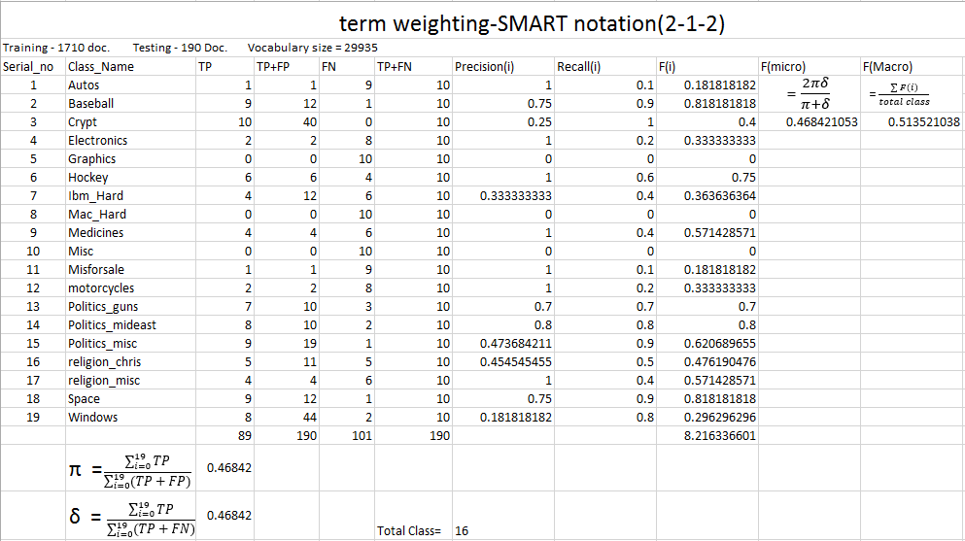
Result

Slide 23
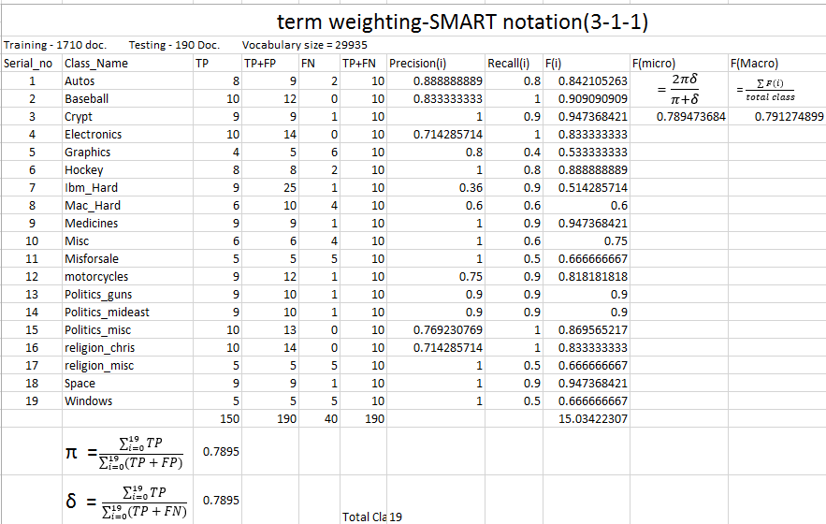
Result

Slide 24
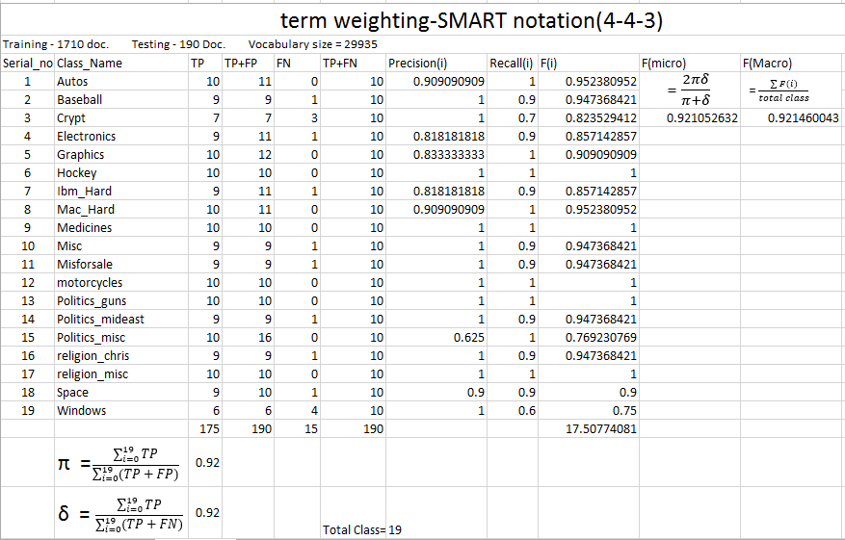
Result

Slide 25
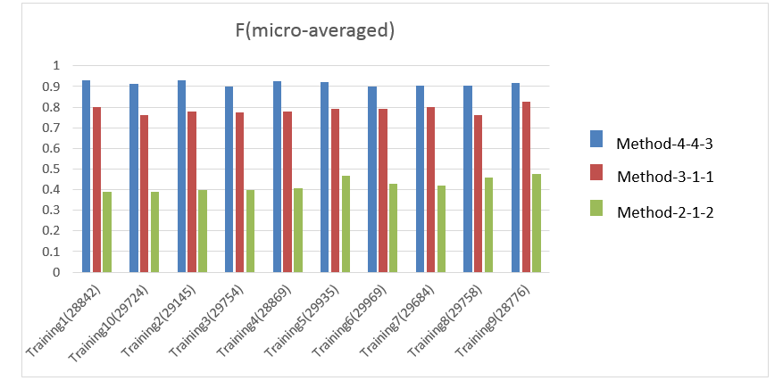
Result

Slide 26
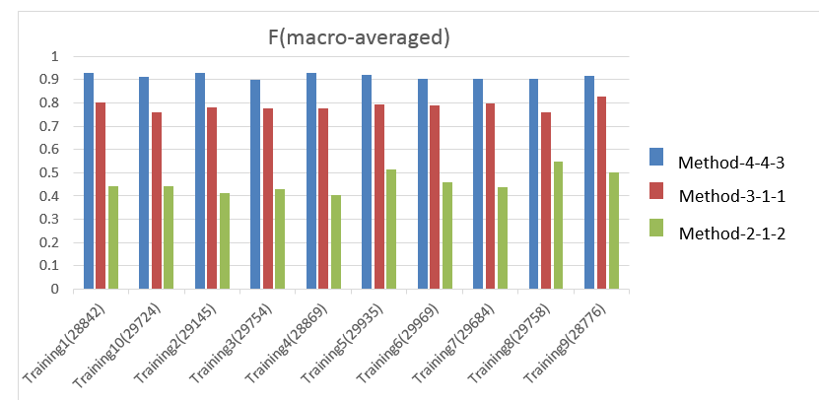
Result

Slide 27
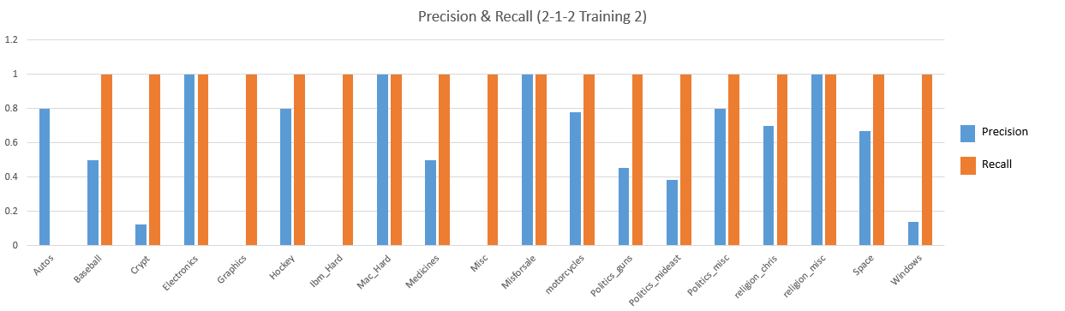
Result

Slide 28
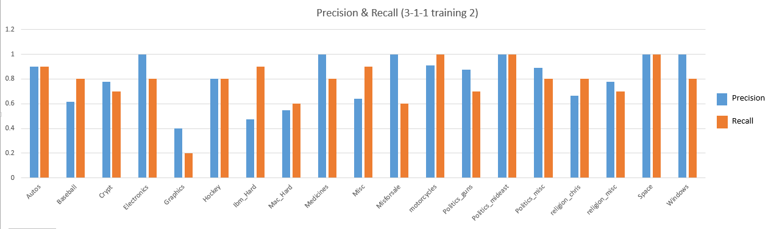
Result

Slide 29
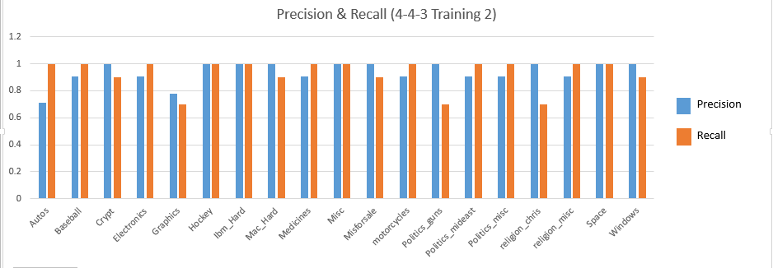
Result

Slide 30
Application of document classification
Document Classification is used in
Webpage classification
Spam filtering
Automatic patent filing
Identification of song lyrics genre
News article classification
…

Slide 31
Conclusion
The naive Bayes model is widely used because of its simplicity.
It is one of the oldest formal classification algorithms.
It is widely used in areas such as text classification and spam filtering.
A large number of modifications have been introduced, by the statistical, data mining, machine learning, and pattern recognition communities, in an attempt to make it more flexible.
such modifications are necessarily complications, which detract from its basic simplicity.

